Slide 1


SMART HOSPITAL MONITORING SYSTEM
TEAM NAME: TEAM ASPIRANTS
PRESENTED BY:
S.Md Ashwak – 3529
P.Daniel Pixley – 3506
Santhosh – 3507
Adnan Ali – 3501
GPCET
REVIEW
2023

Slide 2
AGENDA
To monitor and display the temperature , pressure , humidity and Air Quality in environment.
To remotely monitor patient’s Heartrate and SPo2 oxygen levels
To monitor levels of glucose left in saline bottle.
Hence to resolve these problems we came up with a solution , “The Smart Hospital Monitoring System”.
GPCET
REVIEW
2023

Slide 3

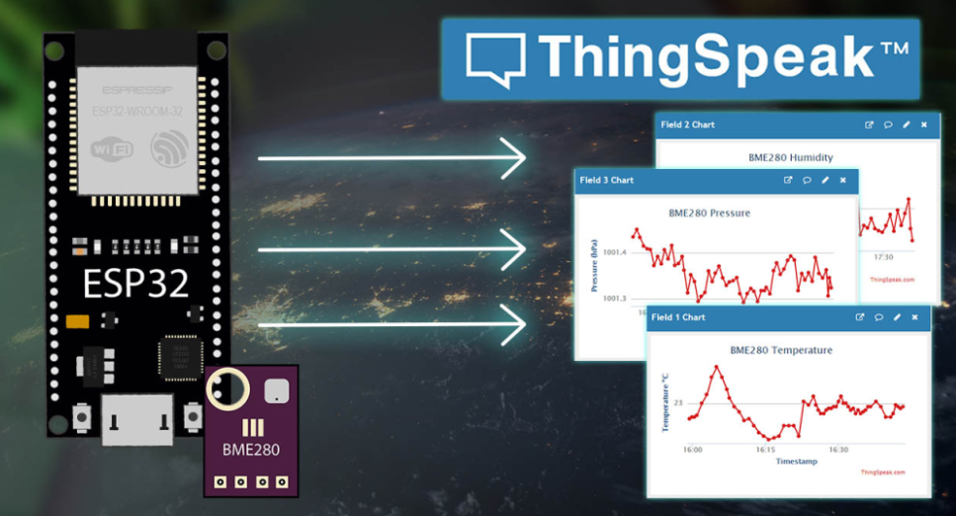
LIST OF SOFTWARES USED :
1. Arduino IDE :
Arduino IDE Is An Integrated Development Environment Which Enable Us To Program And Upload The Codes Onto Different Types Of Microcontrollers Like Arduino , Esp32, Esp8266..Etc
2. ThingSpeak Cloud platform :
Thingspeak Is A “Paas” Cloud Platform Which Is Student Oriented Which Helps Students Build Projects Based On Cloud Applications And Use Multiple Of Their Features For Free.
GPCET
REVIEW
2023

Slide 4
LIST OF LIBRARIES USED :
1. <WiFi.h>
The WiFi.h library is used to interface with Wi-Fi networks and allow
for communication with the Internet in Arduino projects. It provides
high-level functions for connecting to Wi-Fi networks, sending and
receiving data over the network, and managing network connections.
2. <ThingSpeak.h>
The ThingSpeak.h library enables Arduino projects to send and receive
data with ThingSpeak, a cloud-based IoT platform. It provides a simple
set of functions for accessing the ThingSpeak API, making it easier to store
, analyze, and visualize data from IoT projects.
GPCET
REVIEW
2023

Slide 5
LIST OF LIBRARIES USED :
3. <HX711.h>
The HX711 library is used to interface with HX711 amplifiers
and simplify the process of obtaining accurate weight
measurements from weight sensors.
4. <adafruit_BME680.h>
The Adafruit_BME680 library is used to simplify accessing
and controlling the BME 680 sensor, providing a convenient
and consistent interface for reading the sensor’s
measurements and controlling its operation.
GPCET
REVIEW
2023

Slide 6
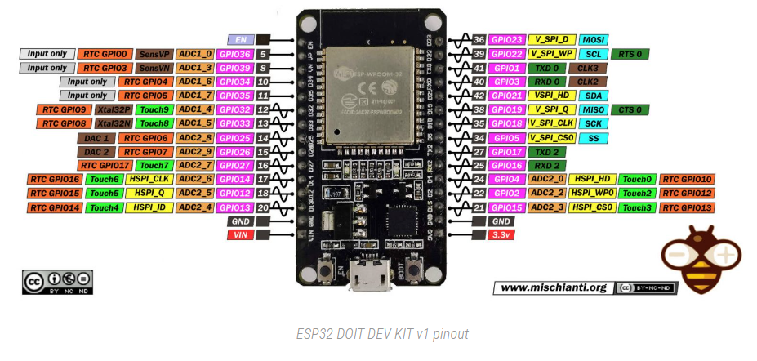
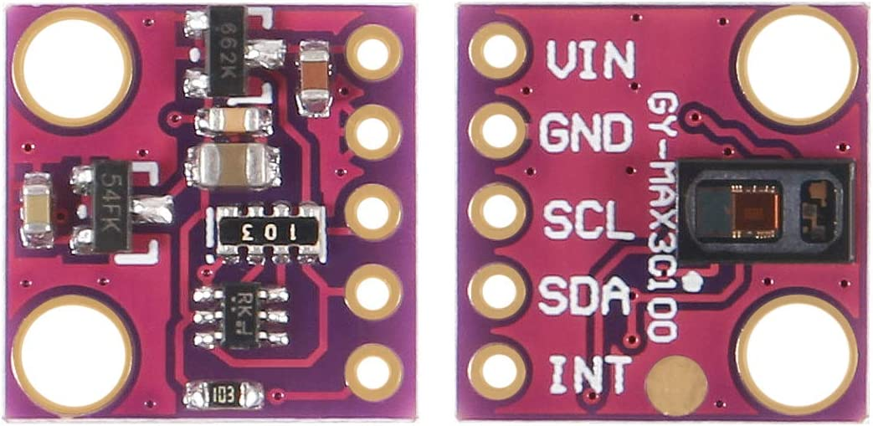
HARDWARE AND ITS USES :
ESP32 MICROCONTROLLER :
MAX 30100 :
ESP32 is a series of low-cost, microcontroller with integrated WiFi and dual-mode Bluetooth.
The MAX30100 is a sensor for pulse oximetry and heart rate monitoring that determines oxygen saturation and heart rate through red and infrared light measurement.
GPCET
REVIEW
2023

Slide 7
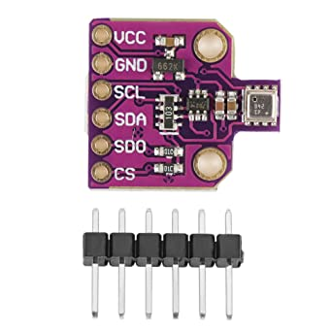
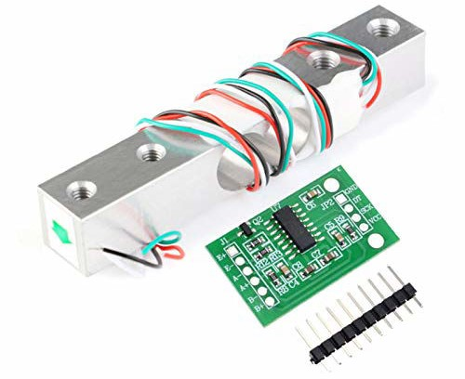
HARDWARE AND ITS USES :
LOAD CELL:
BME 280 :
A load cell is a device used to measure weight or force. It works by converting the physical force into an electrical signal that can be read and processed by a computer or other device.
BME 280 is a highly integrated environmental sensor that measures temperature, humidity, pressure, and indoor air quality
GPCET
REVIEW
2023

Slide 8
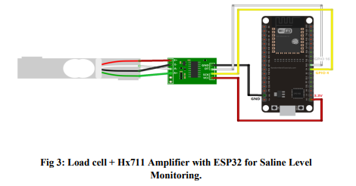
CIRCUIT DIAGRAM OF HARDWARE
GPCET
REVIEW
2023

Slide 9
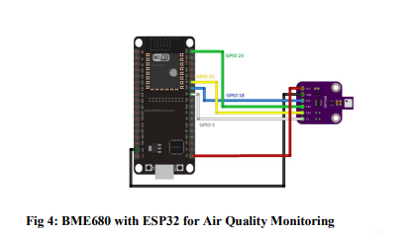
CIRCUIT DIAGRAM OF HARDWARE
GPCET
REVIEW
2023

Slide 10
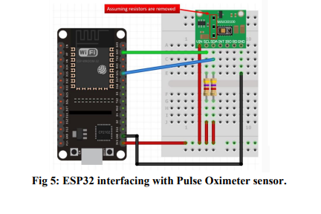
CIRCUIT DIAGRAM OF HARDWARE
GPCET
REVIEW
2023

Slide 11
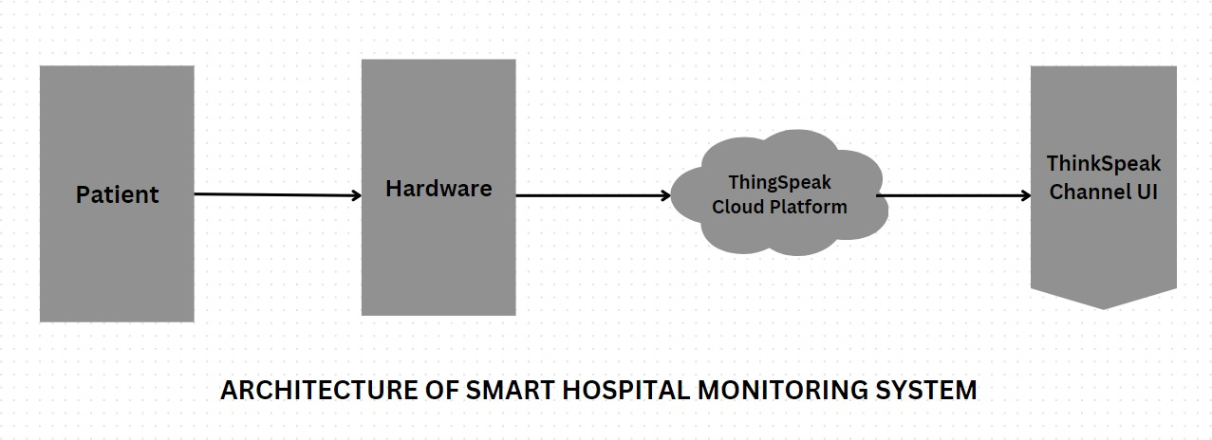
ARCHITECTURE OF SMART HOSPITAL MONITORING SYSTEM
GPCET
REVIEW
2023

Slide 12
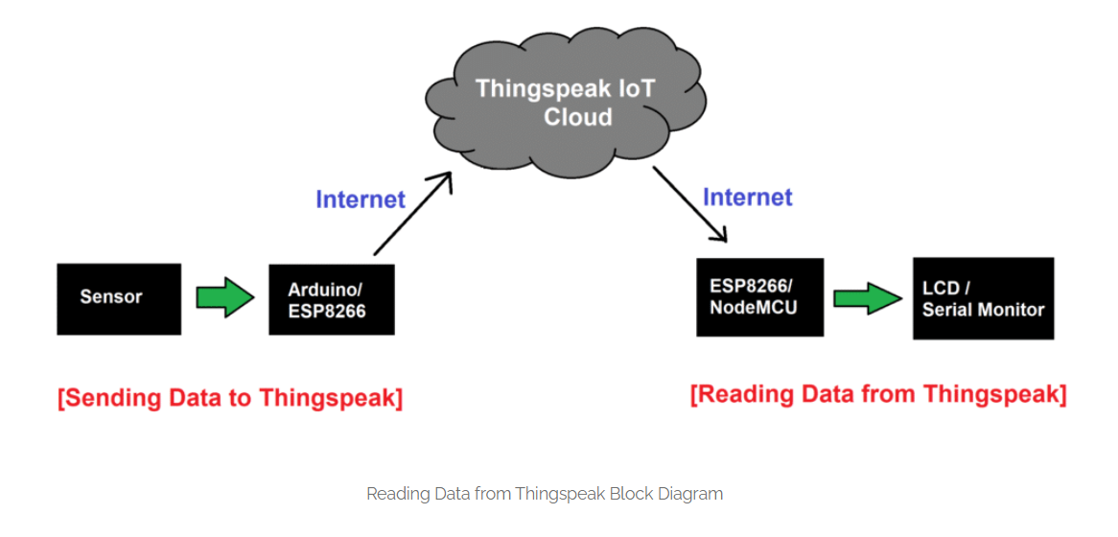
BLOCK DIAGRAM ( SERVER )
ThingSpeak channel UI
GPCET
REVIEW
2023

Slide 13
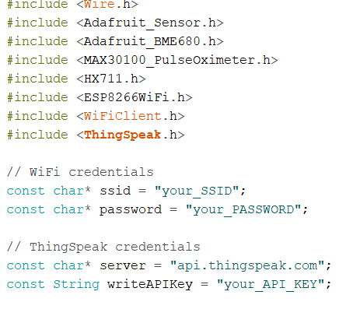
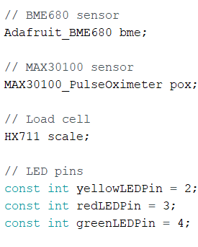
PROGRAM LOGIC FOR THINGSPEAK
READING VALUE FROM THINGSPEAK CLOUD AND WRITING CONDITIONS :
1. IMPORTING LIBRARIES AND INITIALIZING API KEYS. 2. Initialize Sensors
GPCET
REVIEW
2023

Slide 14
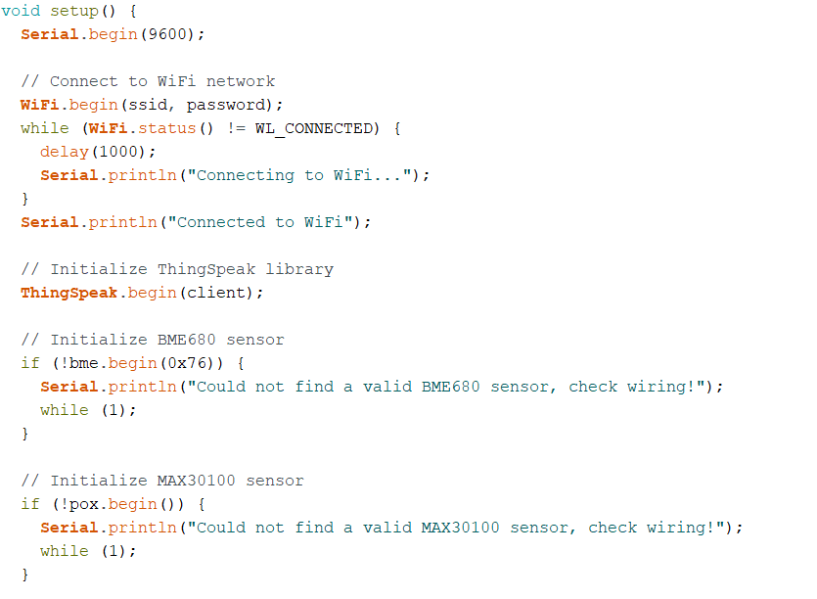
Connect to Wifi and Send data to ThingSpeak
GPCET
REVIEW
2023

Slide 15
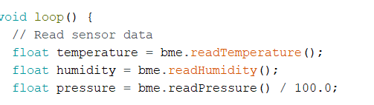
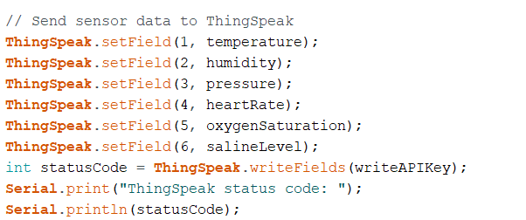
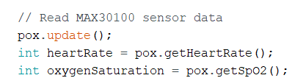
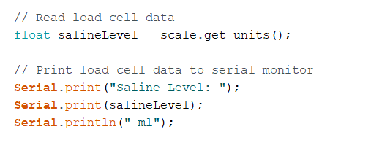
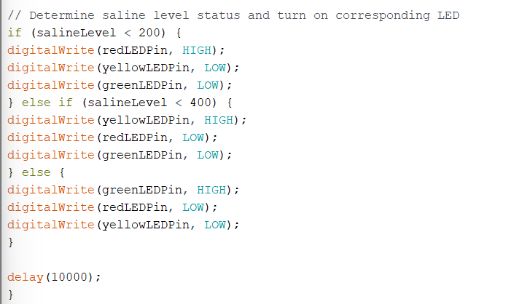
GPCET
REVIEW
2023

Slide 16
IMPLEMENTATION
MAKE ALL THE CONNECTIONS AS PER THE CIRCUIT DIAGRAM
2. CREATING CHANNEL ON THING ThingSpeak CLOUD PLATFORM
3. COMPILING AND UPLOADING THE PROGRAM IN ARDUINO IDE.
GPCET
REVIEW
2023

Slide 17
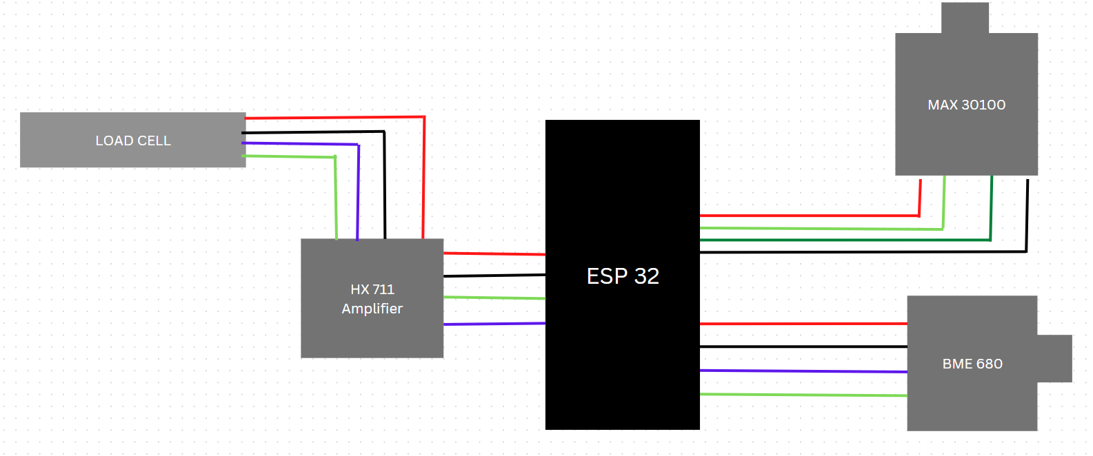
1. MAKING HARDWARE CONNECTIONS AS PER CIRCUIT DIAGRAM
GPCET
REVIEW
2023

Slide 18
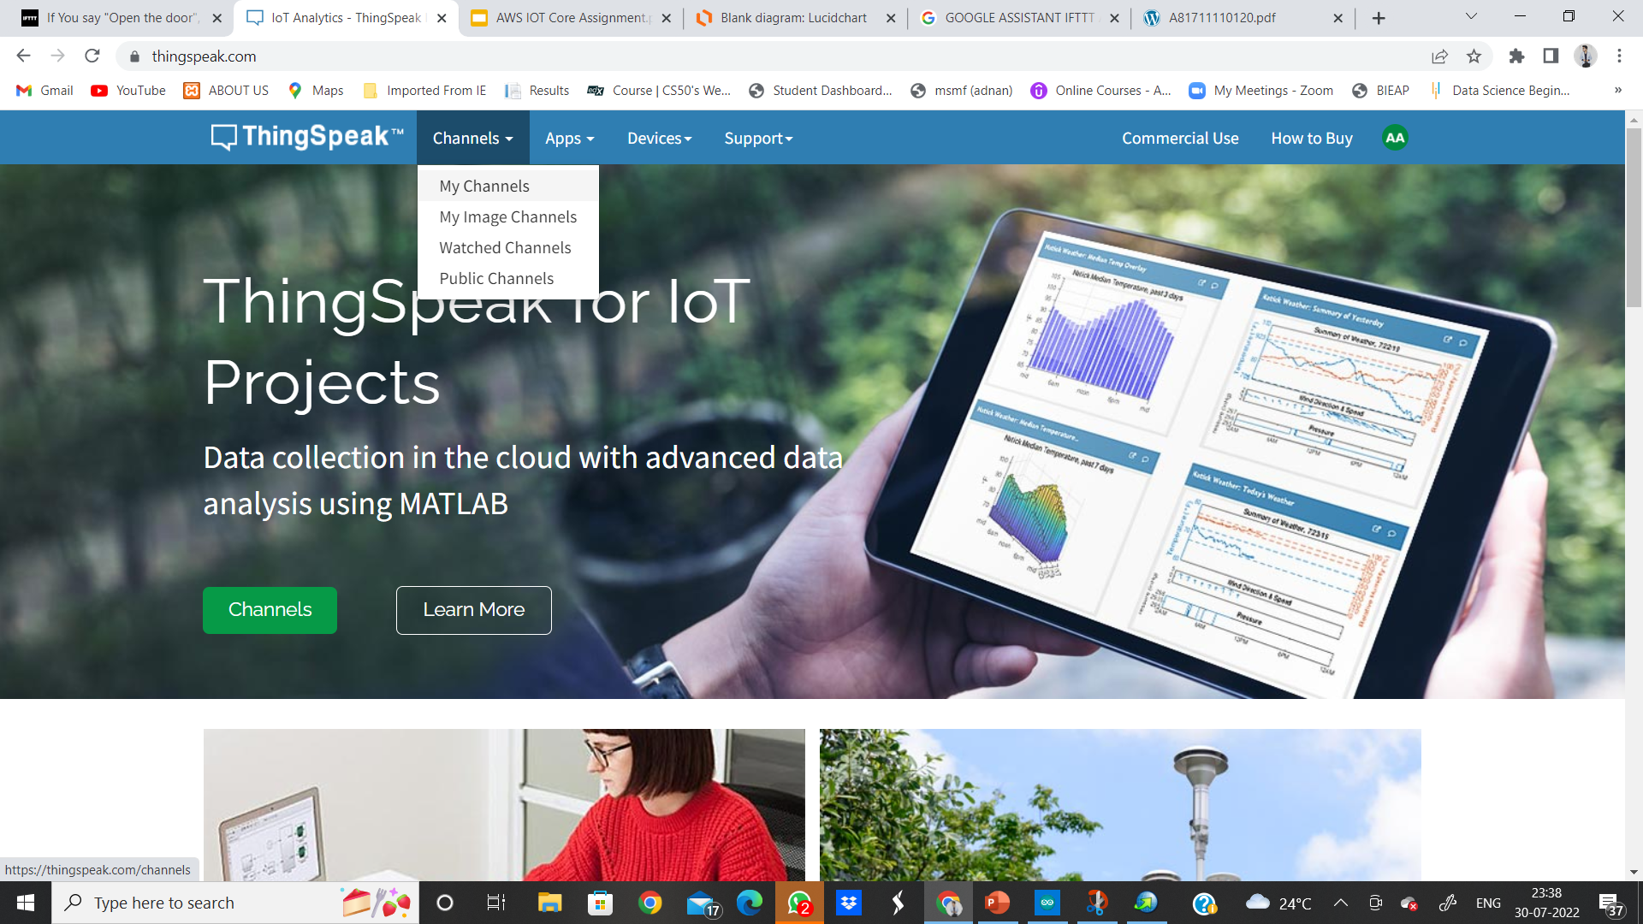
2. CREATING CHANNEL AND FIELDS ON THINGSPEAK
GPCET
REVIEW
2023

Slide 19
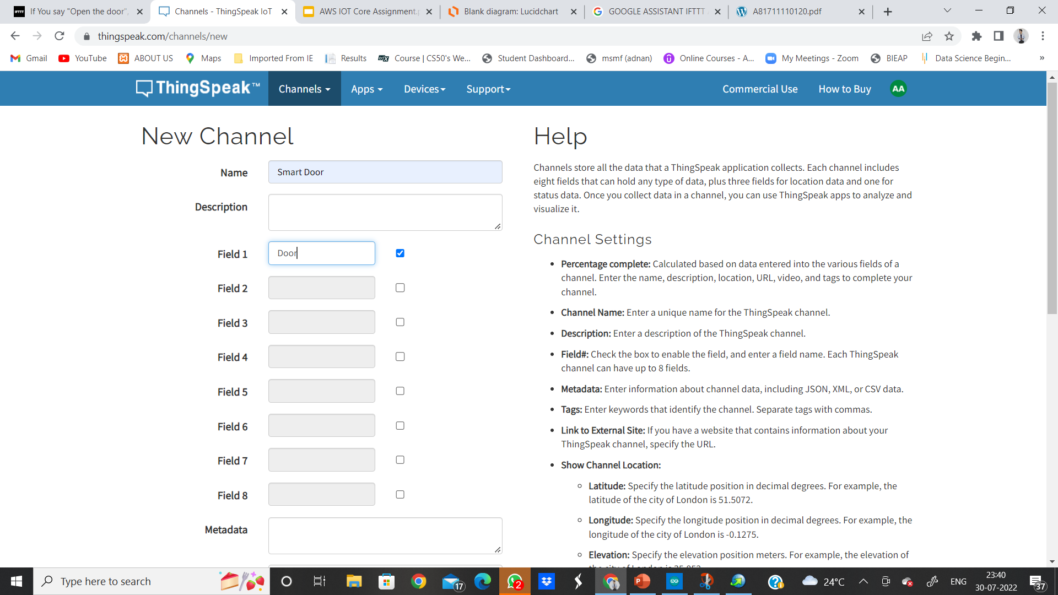
IN MY CHANNEL –> NEW CHANNEL –> FILL ALL DETAILS AS FOLLOWS
GPCET
REVIEW
2023

Slide 20
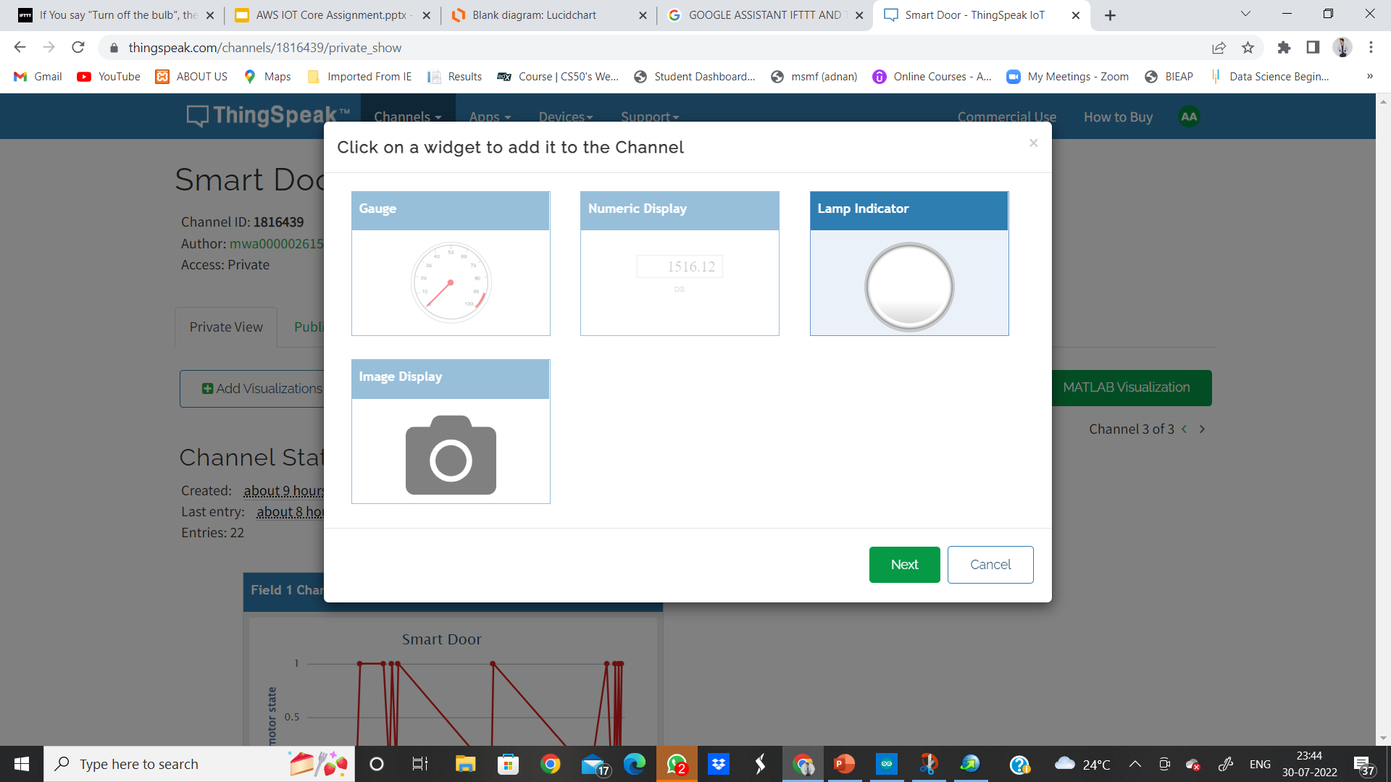
ONCE A CHANNEL IS CREATED → ADD WIDGET→SELECT LAMP INDICATOR
GPCET
REVIEW
2023

Slide 21
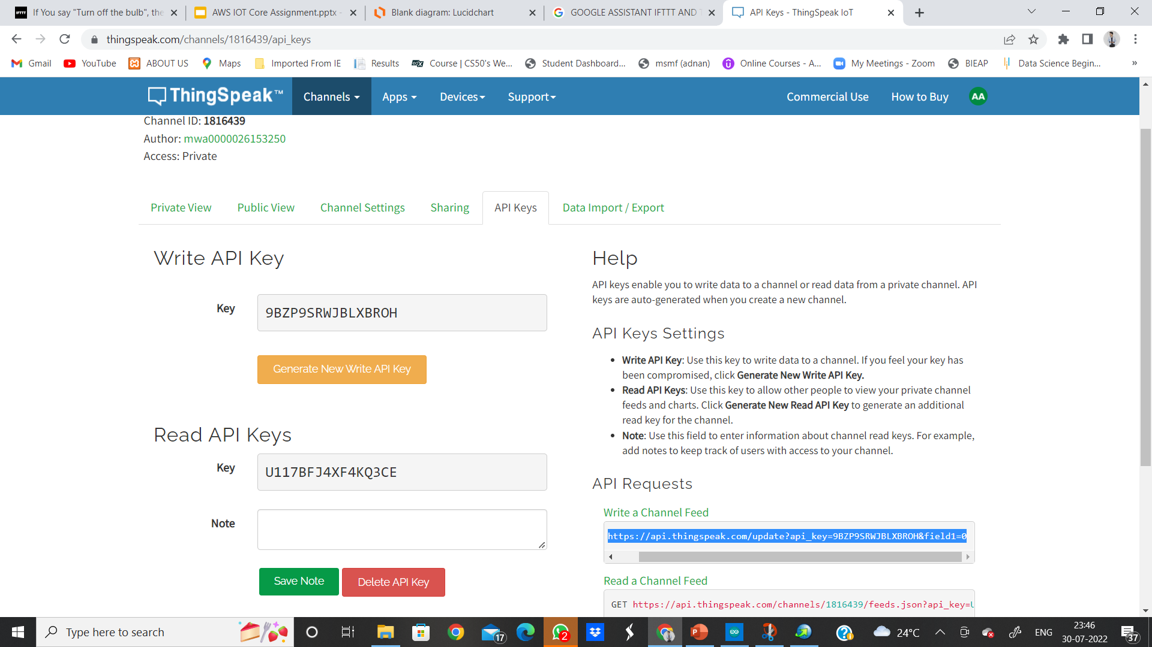
IN MY CHANNEL → API KEYS → AND COPY THE READ &WRITE API KEY AND ALSO THE HIGHLIGHTED URL
GPCET
REVIEW
2023

Slide 22
REMEMBER THE WRITE FIELD URL WHICH WE COPIED IN OUR CHANNEL API KEYS IN THINGSPEAK.
GPCET
REVIEW
2023

Slide 23
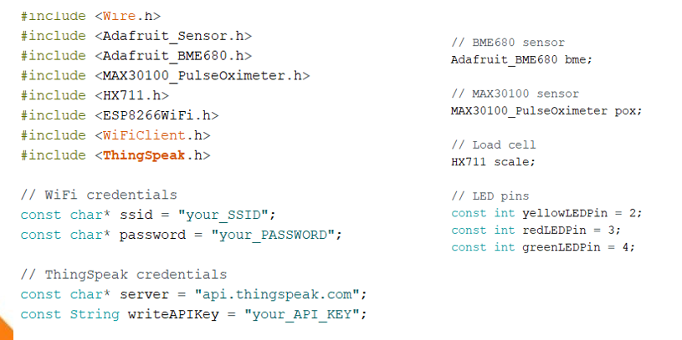
3. COMPILING AND UPLOADING THE PROGRAM
GPCET
REVIEW
2023

Slide 24
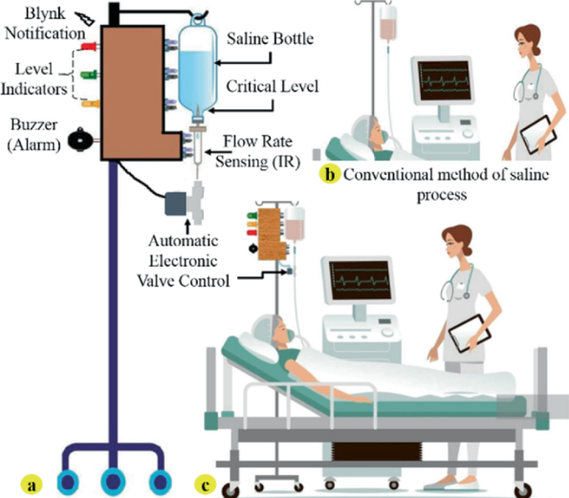
Expected Output Saline Level Monitoring System.

Slide 25
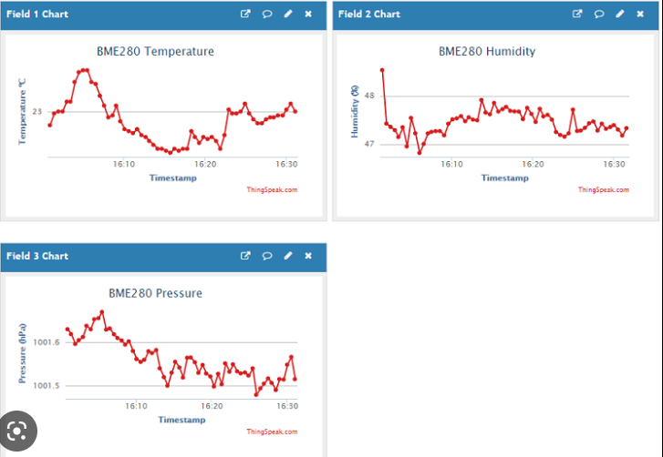
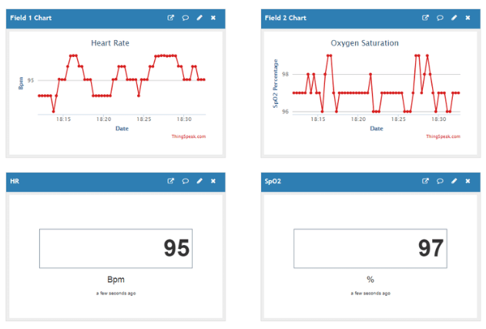
Displaying Data on ThingSpeak Channel

Slide 26
CONCLUSION
UPON COMPLETION OF THE PROJECT WE GOT TO LEARN:
1. HOW TO INTERFACE LOAD CELL AND BME6800 WITH ESP32 MICROCONTROLLER.
2. HOW TO WRITE AND READ DATA FROM THING SPEAK CLOUD PLATFORM.
3. CREATING A SMART HOSPITAL MONITORING SYSTEM APPLICATION THAT MONITORS HUMAN HEALTH REGULARLY AND GIVES HEALTH STATUS OF A TO THE DOCTOR .
5. TO MONITOR PATIENT’S HEALTH REGULARLY FROM ANYWHERE USING OUR SMART PHONE.
GPCET
REVIEW
2023

Slide 27
“It’s one small step for man, one giant leap for mankind.” THANK YOU ! Have a Wonderful Wednesday!!
GPCET
REVIEW
2023

